Slide 1
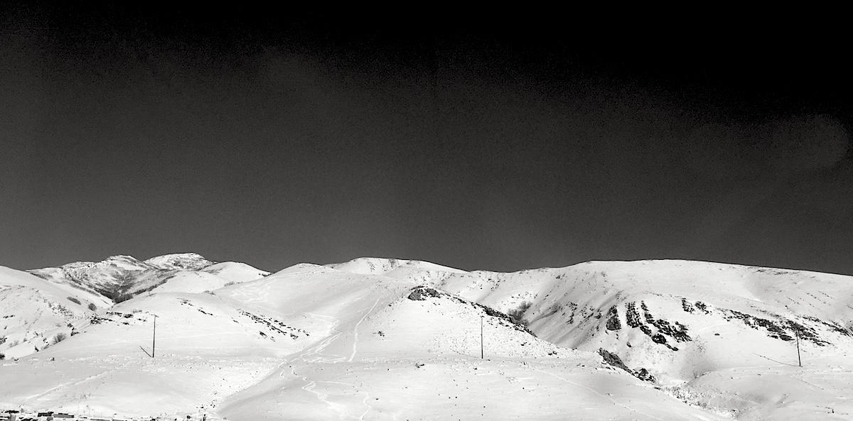
Course overview and introduction to UNIX
Applied Computational Genomics, Lecture 01
https://github.com/quinlan-lab/applied-computational-genomics
Aaron Quinlan
Departments of Human Genetics and Biomedical Informatics
USTAR Center for Genetic Discovery
University of Utah
quinlanlab.org

Slide 2
The gist
More than ever, biology is an inherently computational science. Therefore, as a scientist, you need to understand and take control of every aspect of your research. In a nutshell, this means that you should be able to conduct your experiment, analyze your own data, and think carefully about all caveats therein. As in any other scientific discipline, you must establish expected results, design positive and negative controls, and use appropriate measurements of significance. This requires that you have the right tools to do so.
Analyzing your data means inherently distrusting your data until you have exhausted yourself into giving up and trusting it. This course seeks to teach you how.

Slide 3
Objectives
To teach you the theory and fundamental analysis techniques underlying computational genomics research.
For you to leave this course empowered to improve and expedite your research.

Slide 4
Introductions
Instructor
TAs
Students
Questions
What is your name?
Where are you from?
What lab are you rotating in currently or what is your thesis lab?
What is your favorite movie?
What is the best book you've read in the last year?
What is your favorite thing to do outside of graduate school?
If you could travel anywhere in the world right now, where would you go and why?

Slide 5
Expectations
That you have already completed the prerequisites. If not, do so now.
Attend every class unless not possible (let me know)
Read every article.
Participate in class. If you are confused, please stop me and ask a question! Questions are awesome!
Work hard - it will pay off.

Slide 6
Basics
Course website, no Canvas (changes over the next two weeks): https://github.com/quinlan-lab/applied-computational-genomics
TAs:
Scott Pew
Reilly Falter
TA Hours (TBD):
Course server: malibu.genetics.utah.edu
There will be ~7 homework assignments
Homeworks due by 11:59PM one week after assigned. For example, if assigned on a Tuesday, HW is due at 11:59 PM the following Tuesday.
75% of grade
There will be a group project presented at the end of class
25% of grade

Slide 7
Questions?

Slide 8
A brief, staggeringly incomplete history of computational biology
Recommended reading: “The Evolution of the Unix Time-sharing system”, Dennis M. Ritchie https://pdfs.semanticscholar.org/f64f/6e66da16e93ebf4221fc8915b2420fd56b66.pdf

Slide 9
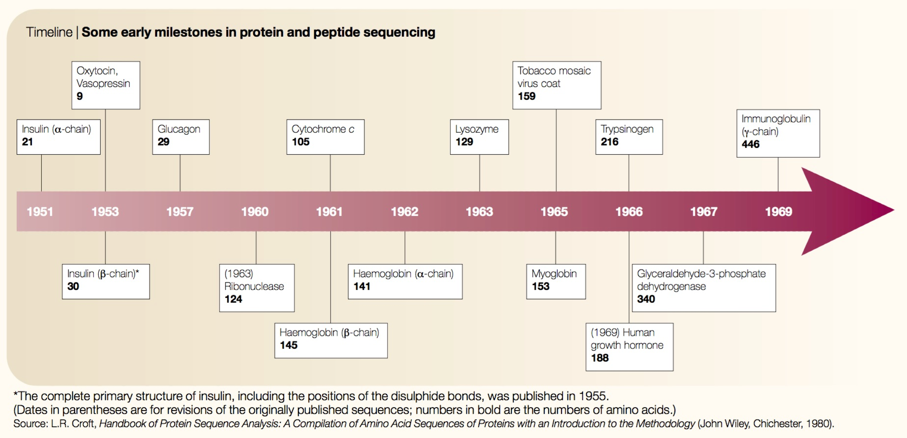
Comp. biology was born in the 1960s
Expanding collection of amino acid sequences in the 1960s
Need for computational power to answer questions and study protein biology
Scarcity of academic computers was no longer a major problem
Joel Hagen, “The origins of bioinformatics”, NRG, Dec. 2000

Slide 10
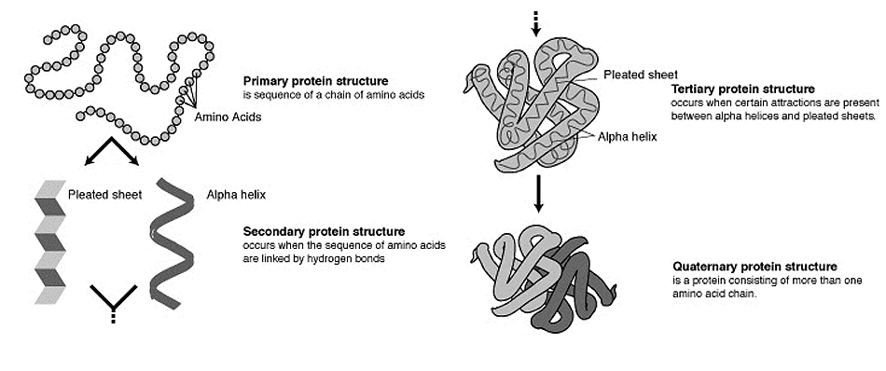
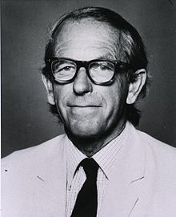
Polypeptide theory of protein structure
Fred Sanger and colleagues sequenced Insulin, the first complete protein sequence from 1945-1955
Established that every protein had a characteristic primary structure
Moore and Stein developed semi-automated sequencing techniques that transformed protein sequencing (sound familiar?)
Frederick Sanger
His first Nobel Prize
1958

Slide 11
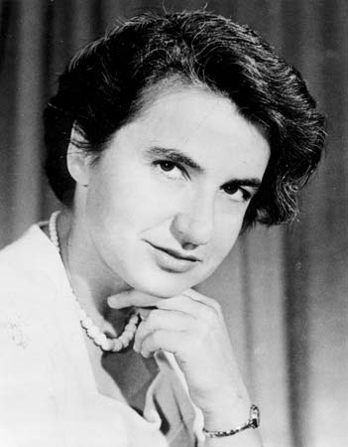
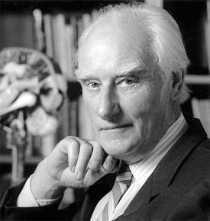
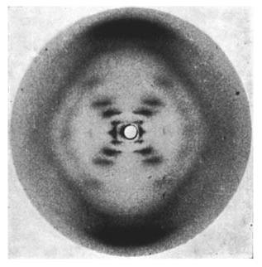
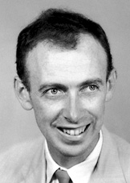
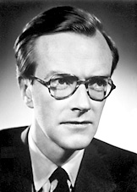
DNA and the genetic code
Rosalind Franklin, Francis Crick, James Watson, and Maurice Wilkins contributed to solving DNA structure and the proposed system for replication
Sequencing DNA proved to be a formidable task
Franklin’s x-ray diffraction of B form DNA

Slide 12
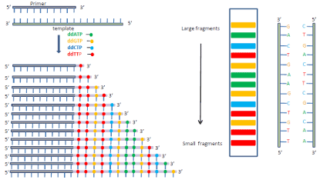
DNA sequencing: Maxam-Gilbert, Sanger
Sanger sequencing key points:
sequencing by synthesis (not degradation); radioactive primers hybridize to DNA
polymerase + dNTPS + ddNTP terminators at low concentration
1 lane per base, visually interpret ladder
Frederick Sanger
His second Nobel Prize
1980

Slide 13
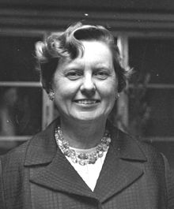
Margaret Dayhoff
Likely the first computational biologist
Trained in math and quantum chemistry
Associate director of the newly-formed National Biomedical Research Foundation
Wrote seminal FORTRAN programs to derive amino acids sequences by using partial overlaps of fragmented amino acid sequences.
From months to minutes!
Realized the applications to nucleic acids and gene sequences.
Margaret Dayhoff

Slide 14
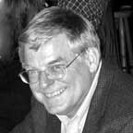
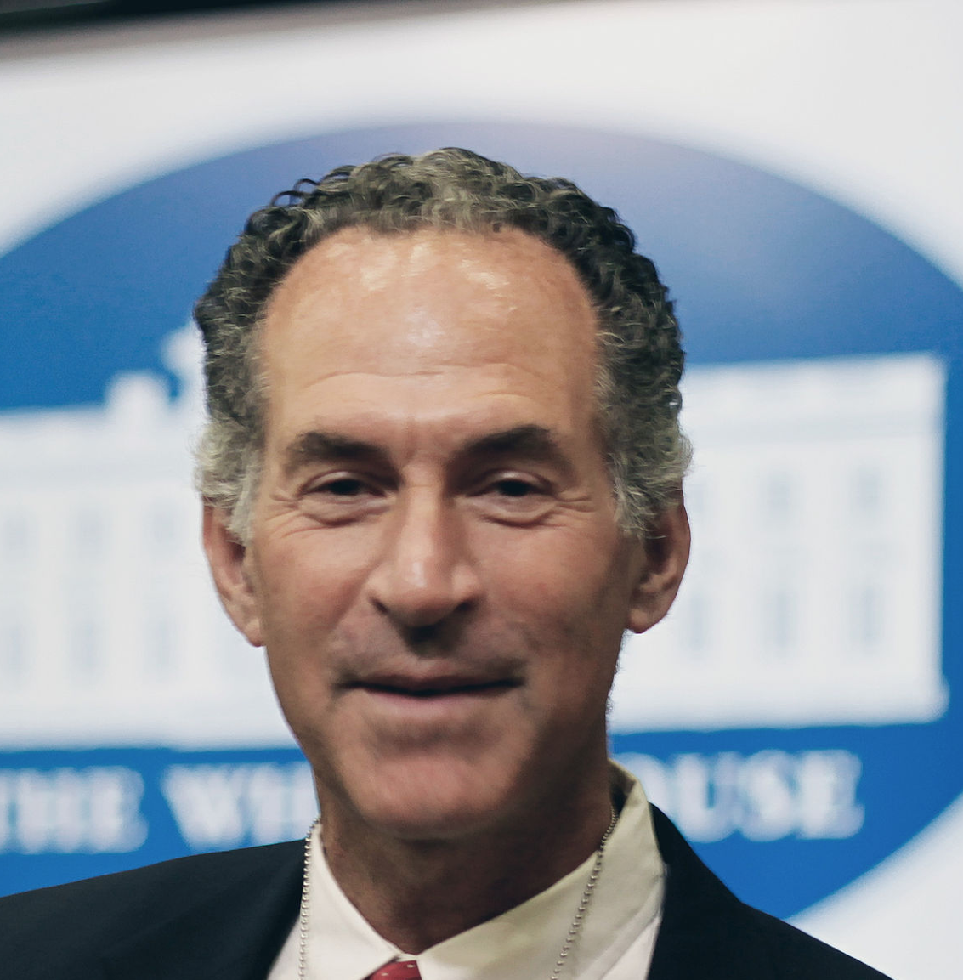
Sequence searching and alignment
FASTA (1985)
BLAST (1990)
Stephen Altschul, Warren Gish, Webb Miller, Eugene Myers, and David J. Lipman
Bill Pearson
David Lipman
Innovation: heuristic database search (speed), followed by optimal alignment (accuracy, statistics)

Slide 15
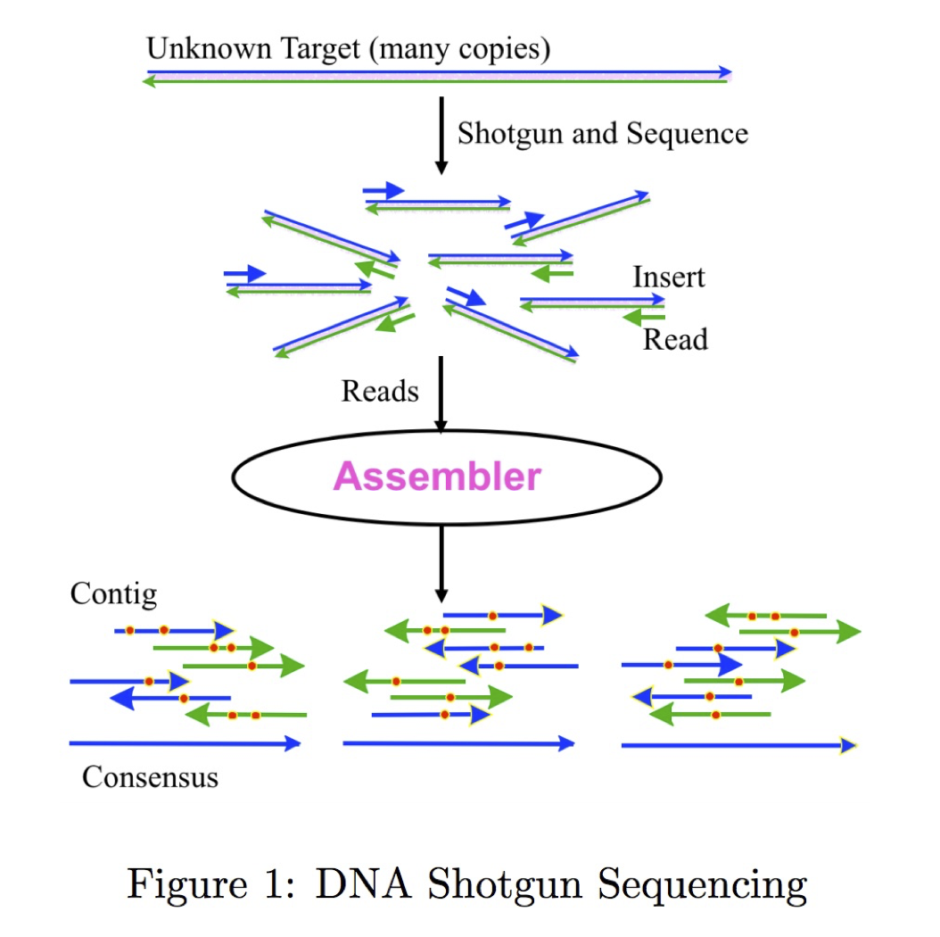
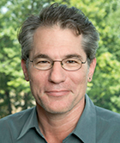
Genome assembly
Inherently challenging computational problem
Large, repetitive genomes
Small “alphabet” (A, C, G, T)
Overlap-Layout-Consensus
String graph
De brujn graphs
Gene Myers
https://dazzlerblog.files.wordpress.com/2016/03/asm-history.pdf

Slide 16

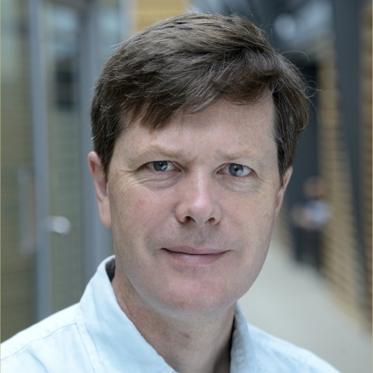
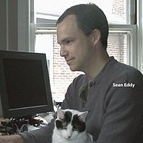
The HMM bible.
Highly influential book describing the use of Hidden Markov Models as probabilistic models of biological sequences
For example, how do we identify a CpG island?
Richard Durbin
Sean Eddy

Slide 17

What is Unix?
Definition 1: Unix is not an acronym; it is a pun on "Multics". Multics was a large multi-user operating system that was being developed at Bell Labs shortly before Unix was created in the early '70s. Brian Kernighan is credited with the name.
Definition 2: Where computational genomics is done.
Definition 3: Your dear friend.
Recommended reading: “The Evolution of the Unix Time-sharing system”, Dennis M. Ritchie https://pdfs.semanticscholar.org/f64f/6e66da16e93ebf4221fc8915b2420fd56b66.pdf

Slide 18
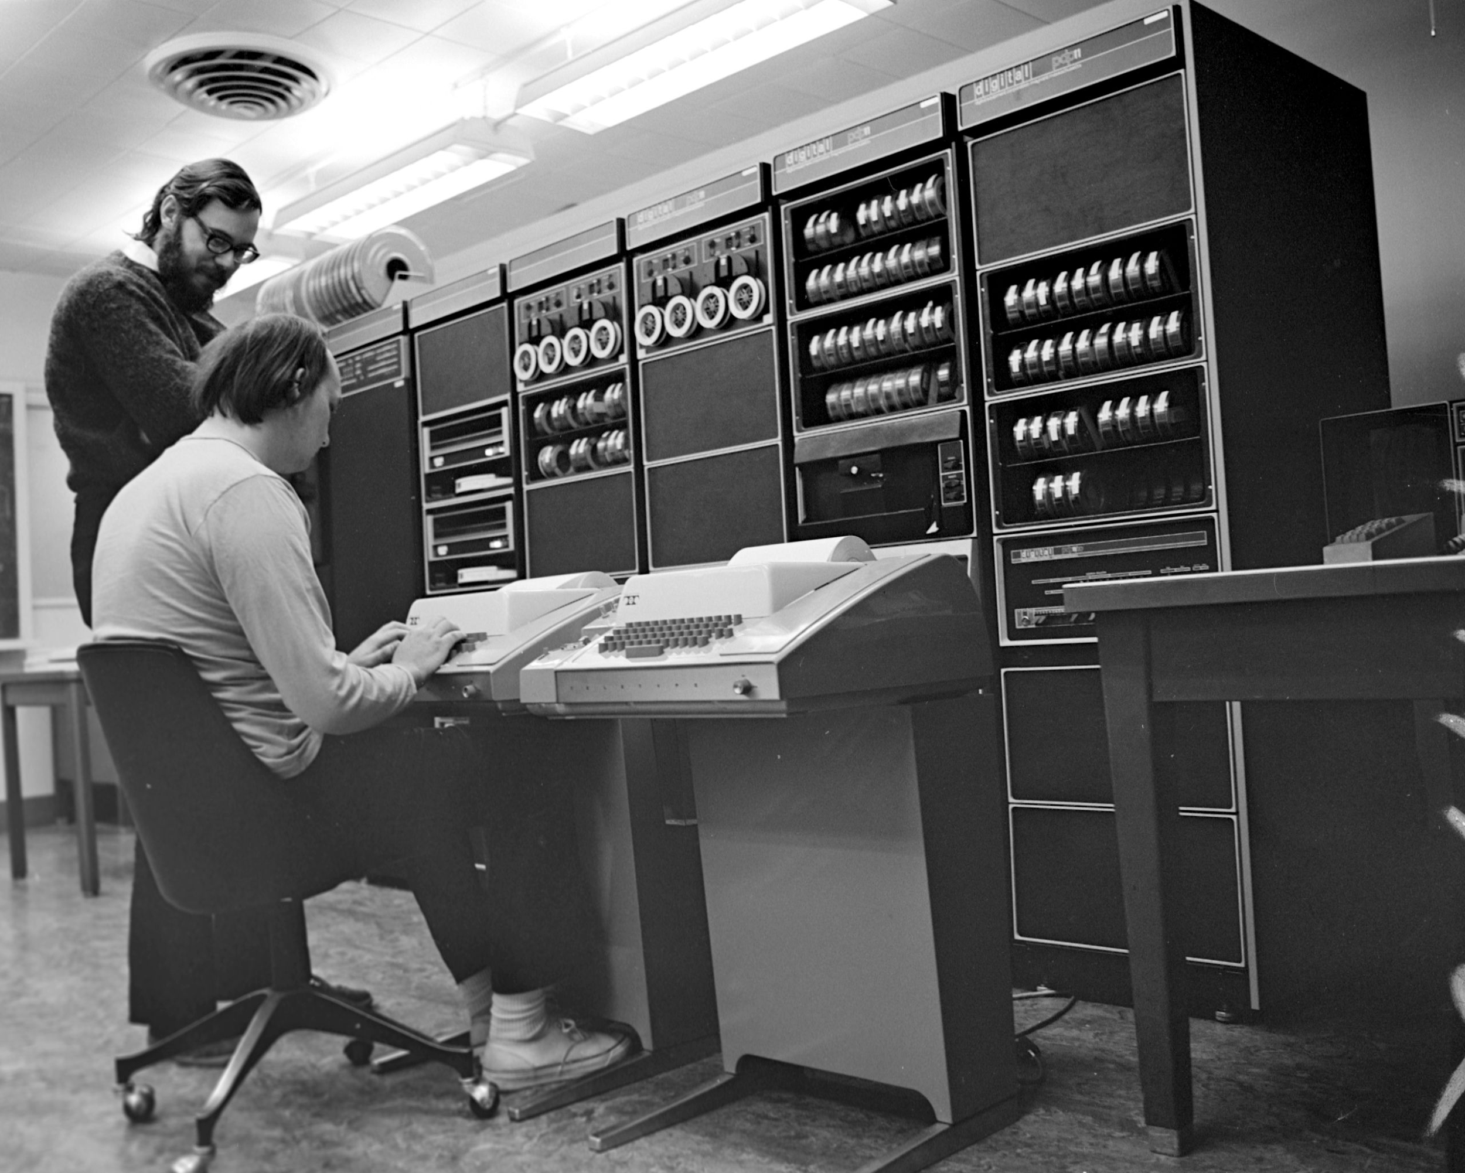
Unix history
Ken Thompson (sitting) and Dennis Ritchie working together at a PDP-11
Initial file system, command interpreter (shell), and process management started by Ken Thompson
Device files and further development from Dennis Ritchie, as well as McIlroy and Ossanna (to a lesser degree)
Vast array of simple, dependable tools that each do one simple task.
By combining these tools, one can conduct rather sophisticated analyses
Wildly popular platform for high performance computing. Supports parallelism.
SunOS/Solaris, IBM's AIX, Hewlett-Packard HP-UX, OSX, Linux, Android, etc.
Credit:https://en.wikipedia.org/wiki/History_of_Unix

Slide 19
Unix basics

Slide 20
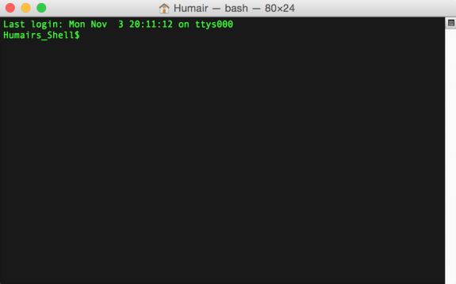
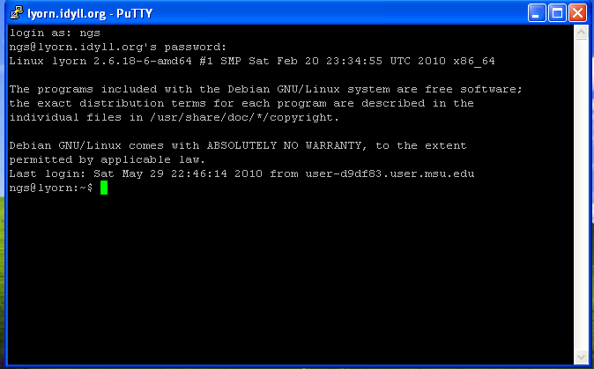
Connecting to a Unix computer via the terminal
“Terminal” in OSX
“putty” for Windows

Slide 21
The “prompt”
The prompt is just a patient little thing that waits around for you to tell it what to do via “commands”.
Command syntax must be exact. In this way, Unix is dumb. It cannot infer what you meant if you misspell, provide the wrong syntax, etc.

Slide 22

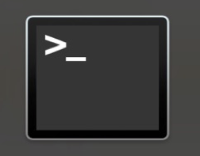
Launching OSX “Terminal”
Applications
Utilities
Terminal

Slide 23
When off campus:
You must use the UU GlobalProtect VPN
(you should have set this up by now)
https://uofu.service-now.com/it?id=uu_kb_article&sys_id=3b8f74b81ba2b810247ceac0604bcb07
Notes:
1. Look for the section called "GlobalProtect installation instructions”
2. Once that is installed, you will connect with your CIS credentials and the URL you want to use for the AnyConnect app is “vpnaccess.utah.edu”
3. I imagine all of you have 2FA setup. You just add “push” as your second password and this will ping your phone or whatever to verify the 2FA.

Slide 24
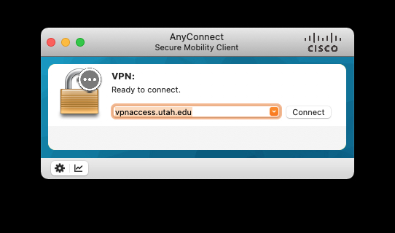

Slide 25
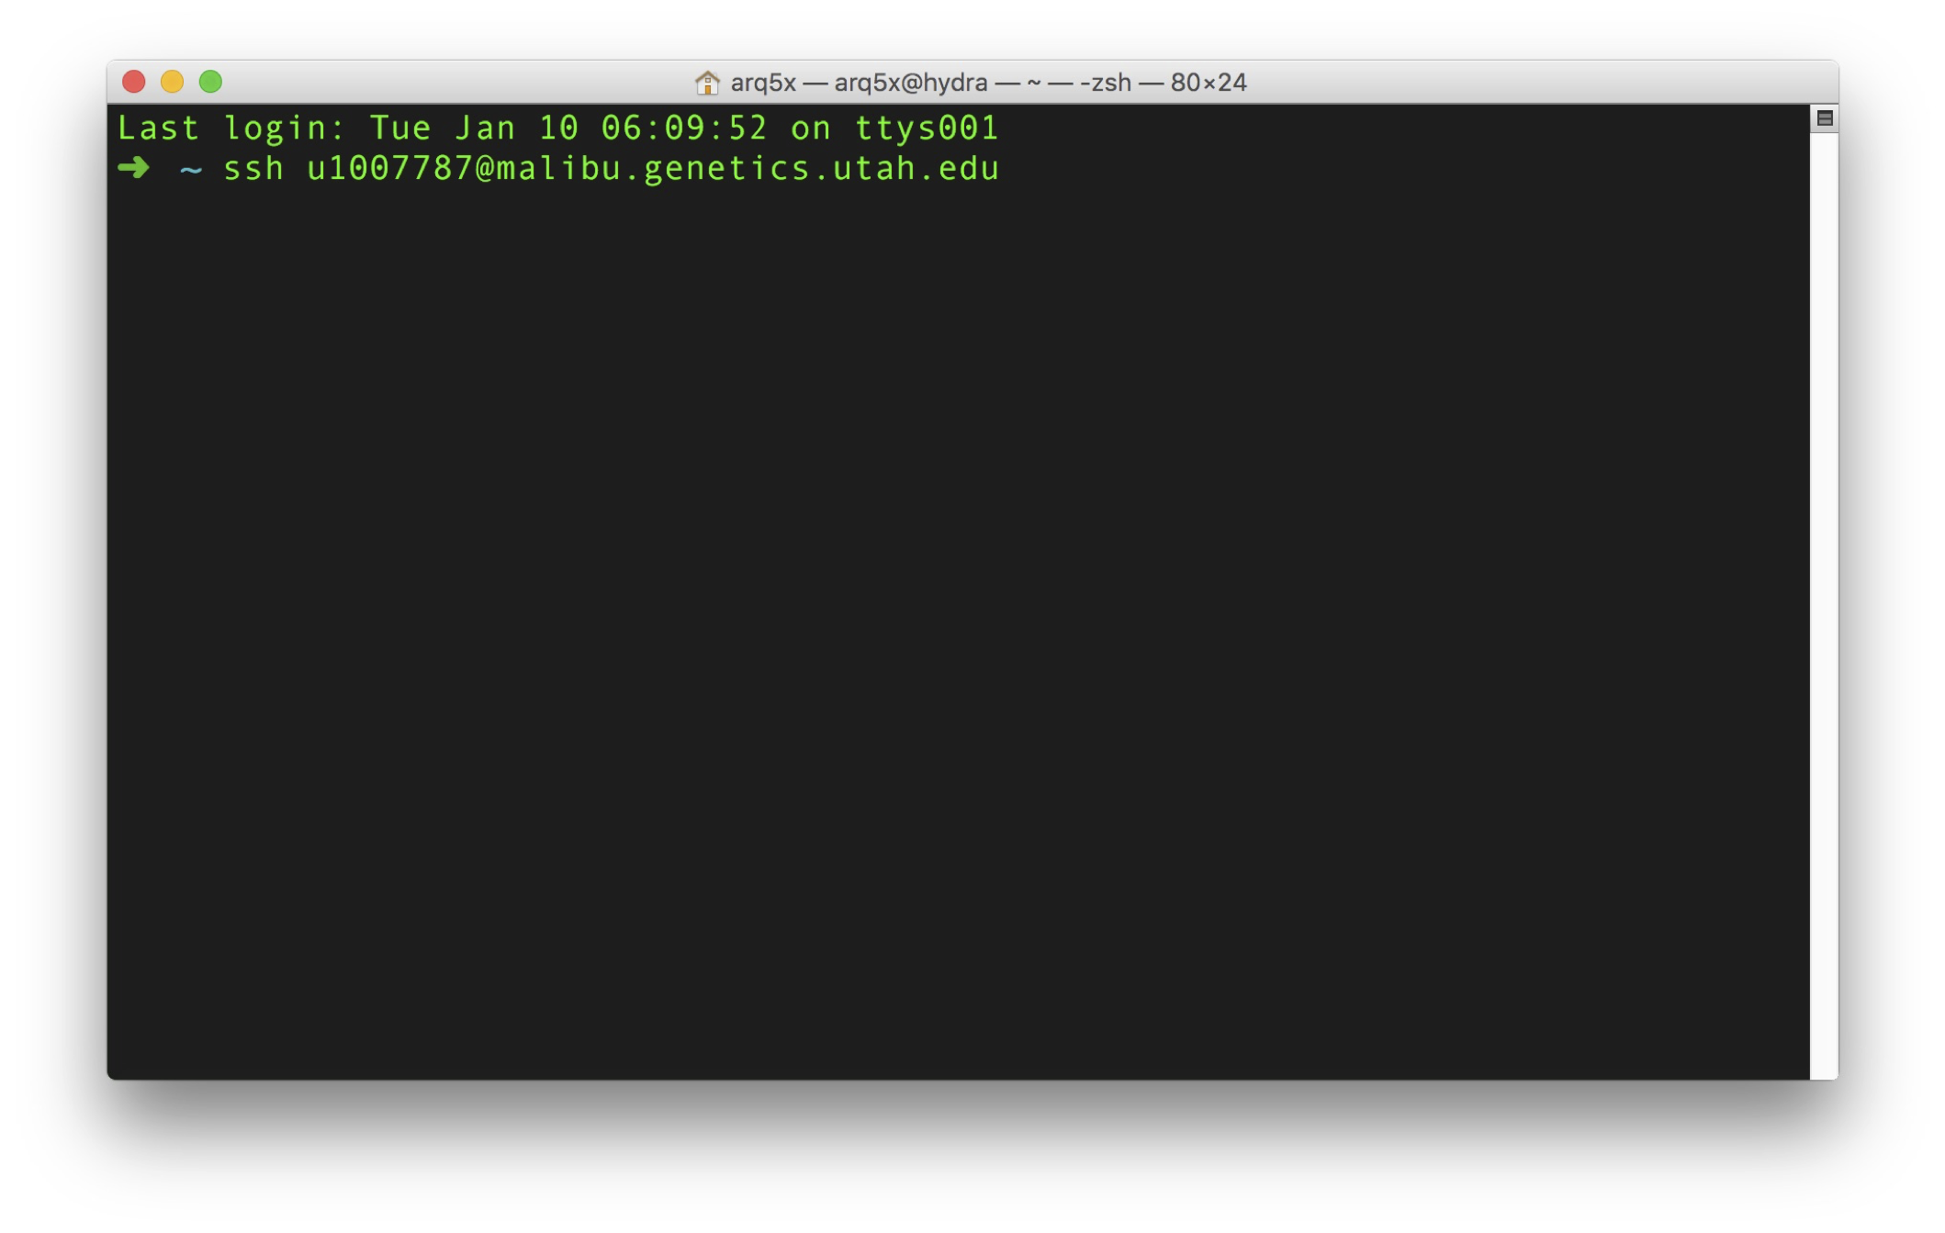
Launching Terminal for OSX
ssh uNID@malibu.genetics.utah.edu
username@hostname
Once you have typed this command (your first UNIX command!), hit Enter.
You will then be prompted for a password: use your CIS password

Slide 26
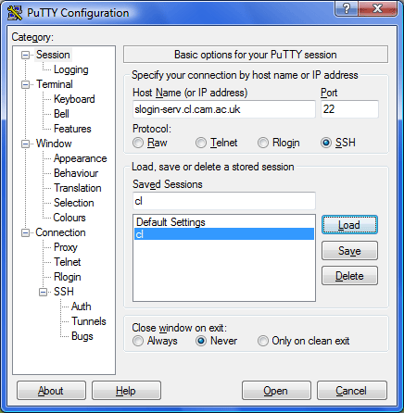
Launching Putty for Windows
malibu.genetics.utah.edu
Save as “malibu”

Slide 27
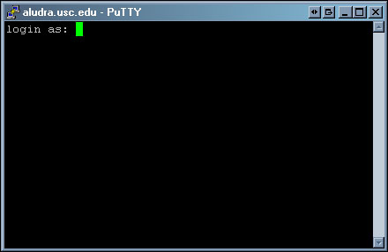
Launching Putty for Windows
malibu.genetics.utah.edu
Your uNID (e.g., u1002281),
Hit enter.
Then enter your CIS password
when prompted.
Hit enter

Slide 28
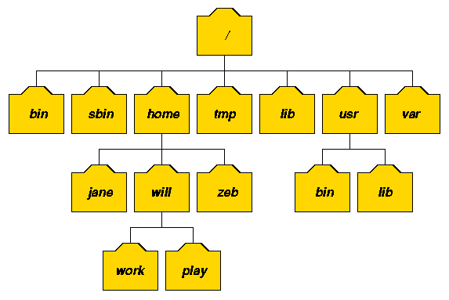
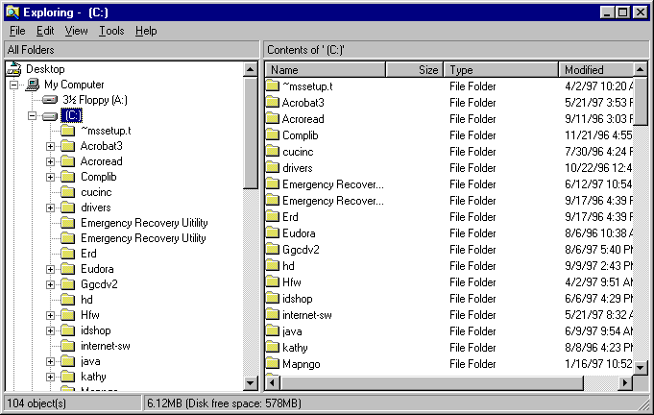
The Unix file system. A tree just like OSX and Windows

Slide 29

The ls command (list files and directories)
(What files and directories can be found in the current directory?)
Example Unix file system (a “tree”)
Image we are user “luke”
$ ssh luke@malibu.genetics.utah.edu
Luke’s home directory
/
list luke’s home directory
command
result to standard
output (stdout)
$ ls
hi.txt proj1
home
bin
vol
luke
leia
ls
head
cat
hi.txt
proj1
data1.txt
data2.txt

Slide 30
The ls command (list files and directories)
(What files and directories can be found in the current directory?)
Example Unix file system (a “tree”)
Image we are user “luke”
$ ssh luke@malibu.genetics.utah.edu
Luke’s home directory
root
list luke’s home directory
$ ls
hi.txt proj1
list luke’s home directory
$ ls ~
hi.txt proj1
home
bin
vol
luke
leia
ls
head
cat
hi.txt
proj1
data1.txt
data2.txt

Slide 31
The ls command (list files and directories)
(What files and directories can be found in the current directory?)
Example Unix file system (a “tree”)
Image we are user “luke”
$ ssh luke@malibu.genetics.utah.edu
Luke’s home directory
root
list luke’s home directory
$ ls
hi.txt proj1
list luke’s home directory
(the tilde means “home”)
$ ls ~
hi.txt proj1
home
bin
vol
list luke’s home directory
$ ls ~luke
hi.txt proj1
luke
leia
ls
head
cat
hi.txt
proj1
data1.txt
data2.txt

Slide 32
The ls command (list files and directories)
(What files and directories can be found in the current directory?)
Example Unix file system (a “tree”)
Image we are user “luke”
$ ssh luke@malibu.genetics.utah.edu
root
list luke’s home directory
$ ls
hi.txt proj1
list luke’s home directory
$ ls ~
hi.txt proj1
home
bin
vol
list luke’s home directory
$ ls ~luke
hi.txt proj1
luke
leia
ls
head
cat
list the “usr” directory
$ ls /home
luke leia
Q: Why does this directory need
a leading “slash”?
A: It is special because it is one “level” below “root”
hi.txt
proj1
data1.txt
data2.txt

Slide 33
The ls command (list files and directories)
(What files and directories can be found in the current directory?)
Example Unix file system (a “tree”)
Image we are user “luke”
$ ssh luke@malibu.genetics.utah.edu
root
list luke’s home directory
$ ls
hi.txt proj1
list luke’s home directory
$ ls ~
hi.txt proj1
home
bin
vol
list luke’s home directory
$ ls ~luke
hi.txt proj1
luke
leia
ls
head
cat
list the “usr” directory
$ ls /home
luke leia
list the content of luke’s “proj1” directory
$ ls proj1
data1.txt data2.txt
hi.txt
proj1
data1.txt
data2.txt

Slide 34
The ls command (list files and directories)
(What files and directories can be found in the current directory?)
Example Unix file system (a “tree”)
Image we are user “luke”
$ ssh luke@malibu.genetics.utah.edu
root
list luke’s home directory
$ ls
hi.txt proj1
list luke’s home directory
$ ls ~
hi.txt proj1
home
bin
vol
list luke’s home directory
$ ls ~luke
hi.txt proj1
luke
leia
ls
head
cat
list the “usr” directory
$ ls /home
luke leia
list the content of luke’s “proj1” directory
$ ls proj1
data1.txt data2.txt
hi.txt
proj1
$ ls ~leia
list the content of leia’s home directory
data1.txt
data2.txt

Slide 35
The cd command (change directories)
(cd helps to navigate through the Unix directory tree)
Example Unix file system (a “tree”)
Image we are user “luke”
list luke’s home directory
$ ls
hi.txt proj1
root
move to luke’s “proj1” directory
$ cd proj1
list luke’s “proj1” directory
home
bin
vol
$ ls
data1.txt data2.txt
Move “up” the tree to luke’s home directory
$ cd ..
$ ls
hi.txt proj1
luke
leia
ls
head
cat
Move “up” the tree to the “usr” directory
$ cd ..
$ ls
luke leia
hi.txt
proj1
$ cd luke/proj1
Move directly to luke’s “proj1” directory
data1.txt
data2.txt
$ cd /bin
Move to the system “bin” directory

Slide 36
The pwd command (present working directory)
(Where am I? That is, in which directory am I?)
Example Unix file system (a “tree”)
Image we are user “luke”
root
Where am I?
$ pwd
/home/luke
move to luke’s “proj1” directory
$ cd proj1
home
bin
vol
Where am I?
$ pwd
/home/luke/proj1
luke
leia
ls
head
cat
move back to luke’s home directory
$ cd ..
Where am I?
$ pwd
/home/luke
hi.txt
proj1
data1.txt
data2.txt

Slide 37
The mkdir command (make a new directory)
Example Unix file system (a “tree”)
Image we are user “luke”
root
Where am I?
$ pwd
/usr/luke
List luke’s home directory
$ ls
hi.txt proj1
home
bin
vol
Move to the “proj1” directory
$ cd proj1
luke
leia
ls
head
cat
Make a new “data” directory in proj1
$ mkdir data
hi.txt
proj1
data1.txt
data2.txt
data

Slide 38
Let's play.

Slide 39
The touch command (create an empty file)
Example Unix file system (a “tree”)
Image we are user “luke”
root
Where am I?
$ pwd
/usr/luke
List luke’s home directory
$ ls
hi.txt proj1
home
bin
vol
Move to the “proj1/data” directory
$ cd proj1/data
luke
leia
ls
head
cat
Create an empty text file called “frost.txt”
$ touch frost.txt
hi.txt
proj1
data1.txt
data2.txt
data
frost.txt

Slide 40
The curl command (download a file)
curl https://gist.githubusercontent.com/arq5x/09bbeea735ee2d3db209d67b635a4b59/raw/f88e5c40fd58369afc18557c2292f6e74aa2e452/frost.txt \
> frost.txt

Slide 41
The head command
(peak at the first n lines in an input file or stream)
The contents of frost.txt
$ head -n 6 frost.txt
Whose woods these are I think I know.
His house is in the village though;
He will not see me stopping here
To watch his woods fill up with snow.
My little horse must think it queer
To stop without a farmhouse near
Between the woods and frozen lake
The darkest evening of the year.
He gives his harness bells a shake
To ask if there is some mistake.
The only other sound’s the sweep
Of easy wind and downy flake.
The woods are lovely, dark and deep,
But I have promises to keep,
And miles to go before I sleep,
And miles to go before I sleep.
Whose woods these are I think I know.
His house is in the village though;
He will not see me stopping here
To watch his woods fill up with snow.
My little horse must think it queer
$ head -n 10 frost.txt
Whose woods these are I think I know.
His house is in the village though;
He will not see me stopping here
To watch his woods fill up with snow.
My little horse must think it queer
To stop without a farmhouse near
Between the woods and frozen lake
The darkest evening of the year.

Slide 42
The head command
(peak at the first n lines in an input file or stream)
-n is an argument or parameter to the head command that modulates its behavior. In this case to report the first 5 lines instead of the first 10, which is the default behavior
The contents of frost.txt
$ head -n 6 frost.txt
Whose woods these are I think I know.
His house is in the village though;
He will not see me stopping here
To watch his woods fill up with snow.
My little horse must think it queer
To stop without a farmhouse near
Between the woods and frozen lake
The darkest evening of the year.
He gives his harness bells a shake
To ask if there is some mistake.
The only other sound’s the sweep
Of easy wind and downy flake.
The woods are lovely, dark and deep,
But I have promises to keep,
And miles to go before I sleep,
And miles to go before I sleep.
Whose woods these are I think I know.
His house is in the village though;
He will not see me stopping here
To watch his woods fill up with snow.
My little horse must think it queer
$ head -n 10 frost.txt
Whose woods these are I think I know.
His house is in the village though;
He will not see me stopping here
To watch his woods fill up with snow.
My little horse must think it queer
To stop without a farmhouse near
Between the woods and frozen lake
The darkest evening of the year.
Important!
Each line ends with a special, hidden character called the newline (\n) character.
This is how “head” knows where the lines start and end.

Slide 43
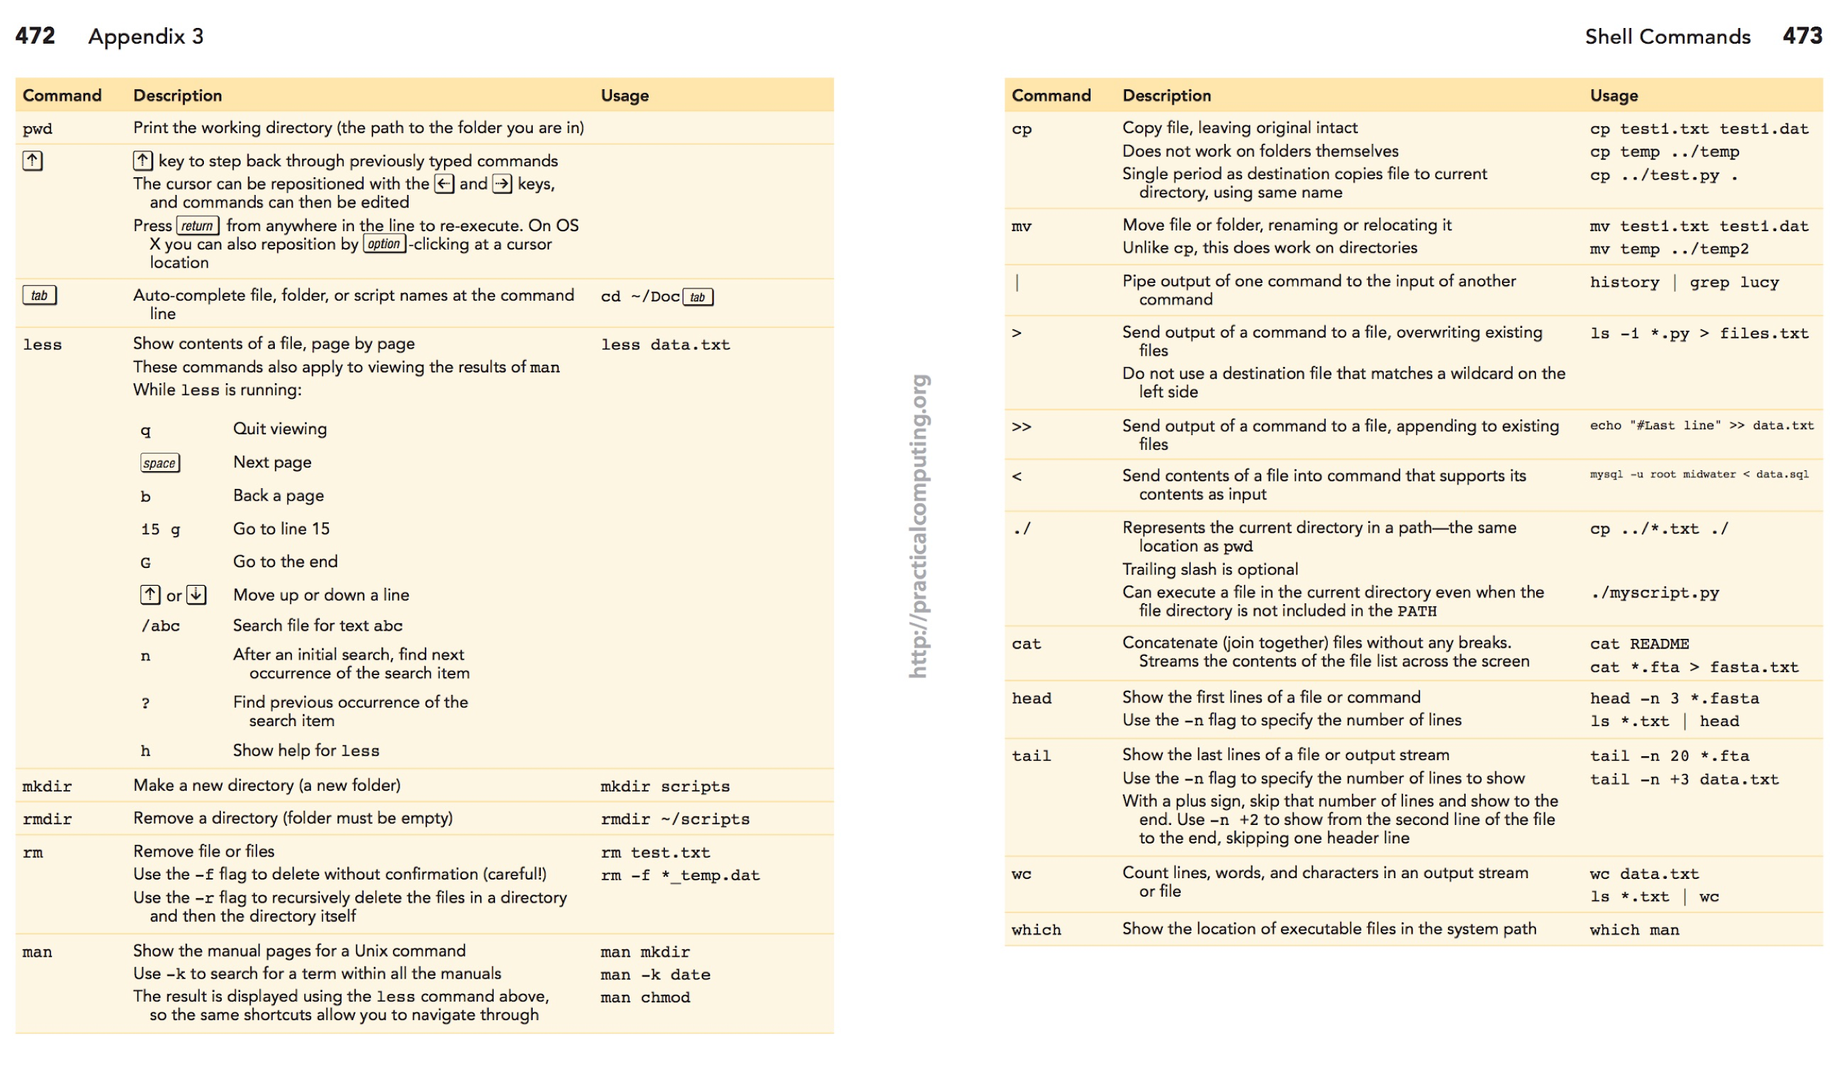
Unix reference “cheat sheet”: (print/mark the link below!)
http://practicalcomputing.org/files/PCfB_Appendices.pdf

Slide 44
